Slide 1
Module 8.2: Basic Security Problems in the Internet Protocol Suite

Slide 2
Problem: no src IP authentication
Client is trusted to embed correct source IP
Easy to override using raw sockets
Libnet: a library for formatting raw packets with arbitrary IP headers (https://repolinux.wordpress.com/2011/09/18/libnet-1-1-tutorial/)
Anyone who owns their machine can send packets with arbitrary source IP
… response will be sent back to forged source IP
Implications
Anonymous DoS attacks;
Anonymous infection attacks (e.g. slammer worm)
Notes:
The worm was based on proof of concept code demonstrated at the Black Hat Briefings by David Litchfield, who had initially discovered the buffer overflow vulnerability that the worm exploited.^{[2]} It is a small piece of code that does little other than generate random IP addresses and send itself out to those addresses. If a selected address happens to belong to a host that is running an unpatched copy of Microsoft SQL Server Resolution Service listening on UDP port 1434, the host immediately becomes infected and begins spraying the Internet with more copies of the worm program.
Home PCs are generally not vulnerable to this worm unless they have MSDE installed. The worm is so small that it does not contain code to write itself to disk, so it only stays in memory, and it is easy to remove. For example, Symantec provides a free removal utility (see external link below), or it can even be removed by restarting SQL Server (although the machine would likely be reinfected immediately).
The worm was made possible by a software security vulnerability in SQL Server first reported by Microsoft on July 24, 2002. A patch had been available from Microsoft for six months prior to the worm's launch, but many installations had not been patched – including many at Microsoft.
The slowdown was caused by the collapse of numerous routers under the burden of extremely high bombardment traffic from infected servers. Normally, when traffic is too high for routers to handle, the routers are supposed to delay or temporarily stop network traffic. Instead, some routers crashed (became unusable), and the "neighbour" routers would notice that these routers had stopped and should not be contacted (aka "removed from the routing table"). Routers started sending notices to this effect to other routers they knew about. The flood of routing table update notices caused some additional routers to fail, compounding the problem. Eventually the crashed routers' maintainers restarted them, causing them to announce their status, leading to another wave of routing table updates. Soon a significant portion of Internet bandwidth was consumed by routers communicating with each other to update their routing tables, and ordinary data traffic slowed down or in some cases stopped altogether. Ironically, because the SQL Slammer worm was so small in size, sometimes it was able to get through when legitimate traffic was not.
Two key aspects contributed to SQL Slammer's rapid propagation. The worm infected new hosts over the sessionless UDP protocol, and the entire worm (only 376 bytes) fits inside a single packet.^{[3][4]} As a result, each infected host could instead simply "fire and forget" packets as rapidly as possible (generally hundreds per second).

Slide 3
Transmission Control Protocol
TCP
Connection-oriented, preserves order
Sender
Break data into packets
Attach packet numbers
Receiver
Acknowledge receipt; lost packets are resent
Reassemble packets in correct order
Book
Mail each page
Reassemble book
1
19
1
5
1

Slide 4
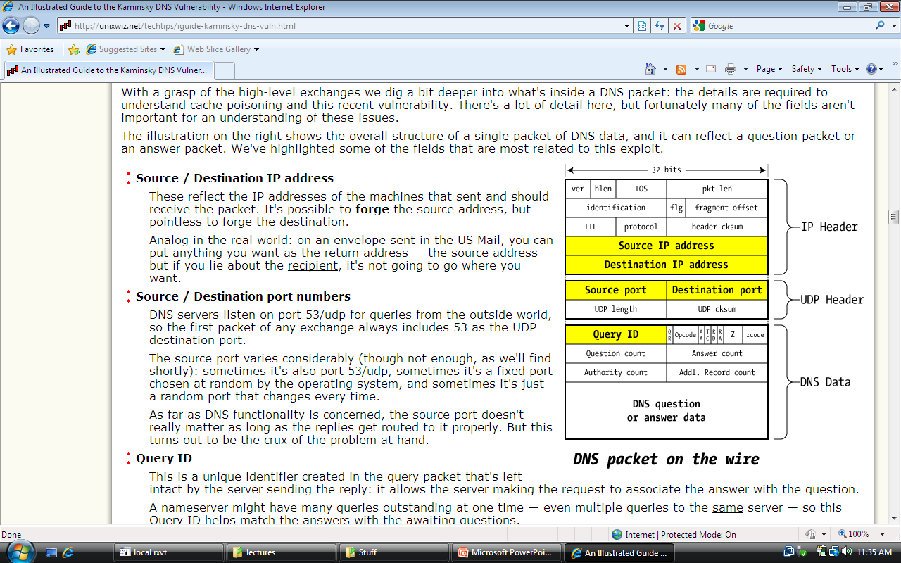
TCP Header (protocol=6)
Source Port
Dest port
SEQ Number
ACK Number
U
R
G
A
C
K
P
S
H
P
S
R
S
Y
N
F
I
N
TCP Header
Other stuff

Slide 5
Review: TCP Handshake
C
S
SYN:
SN_{C}←rand_{C}
AN_{C}←0
Listening
SYN/ACK:
SN_{S}←rand_{S}
AN_{S}←SN_{C}
Store SN_{C} , SN_{S}
Wait
ACK:
SN←SN_{C}+1
AN←SN_{S}
Established
Received packets with SN too far out of window are dropped
http://packetlife.net/blog/2010/jun/7/understanding-tcp-sequence-acknowledgment-numbers/

Slide 6
Basic Security Problems
1. Network packets pass by untrusted hosts
Eavesdropping, packet sniffing
Especially easy when attacker controls a machine close to victim (e.g. WiFi routers)
2. TCP state easily obtained by eavesdropping
Enables spoofing and session hijacking
3. Denial of Service (DoS) vulnerabilities
DDoS

Slide 7
Why random initial sequence numbers?
Suppose initial seq. numbers (SN_{C} , SN_{S} ) are predictable:
Attacker can create TCP session on behalf of forged source IP
Random seq. num. does not block attack, but makes it harder
TCP SYN
Server
attacker
srcIP=victim
Victim
SYN/ACK dstIP=victim
SN=server SN_{S}
ACK
srcIP=victim
AN=predicted SN_{S}
server thinks command is from victim IP addr
command
Notes:
Example commands: send spam email on behalf of victim IP address
SPF: Sender Policy Framework

Slide 8
Example DoS vulnerability: Reset
Attacker sends a Reset packet to an open socket
If correct SN_{S} then connection will close ⇒ DoS
Naively, success prob. is 1/2³² (32-bit seq. #’s).
… but, many systems allow for a large window of acceptable seq. #‘s. Much higher success probability.
Attacker can flood with RST packets until one works
Most effective against long lived connections, e.g. BGP

